Slide 1
Procreation and Contraception
Part 2

Slide 2
NFP vs. contraception: The Barth objection
Four possibilities:
Complete sexual abstinence
Sexual intercourse in the naturally infertile periods
Coitus interruptus
Use of contraceptives
All draw on human arrangement and control; therefore, they are all the same.

Slide 3
NFP vs. Contraception: What’s the difference?
Ends vs. means
What’s wrong with contraception?
Not the use of human intelligence
Not the desire to space children or temporarily avoid having children
The experiential difference

Slide 4
NFP as morally permissible
Not having intercourse for a variety of reasons is permissible (sickness, absence, inconvenience, etc.)
It is permissible to space children and limit family size
There is nothing wrong per se with couples having intercourse or not having intercourse at any particular time
Therefore, it’s not wrong to not have intercourse at certain times in order to limit family size or space children

Slide 5
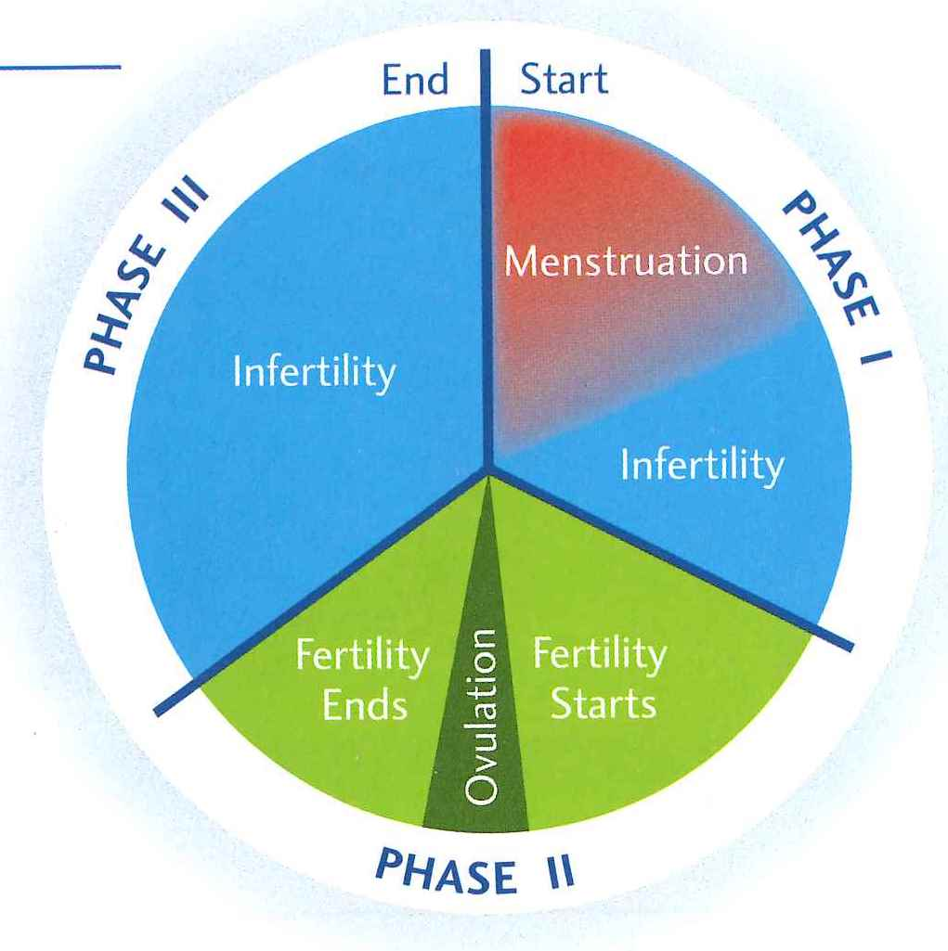
How NFP works
Images from
The Art of Natural
Family Planning,
Couple to Couple
League, 2007

Slide 6
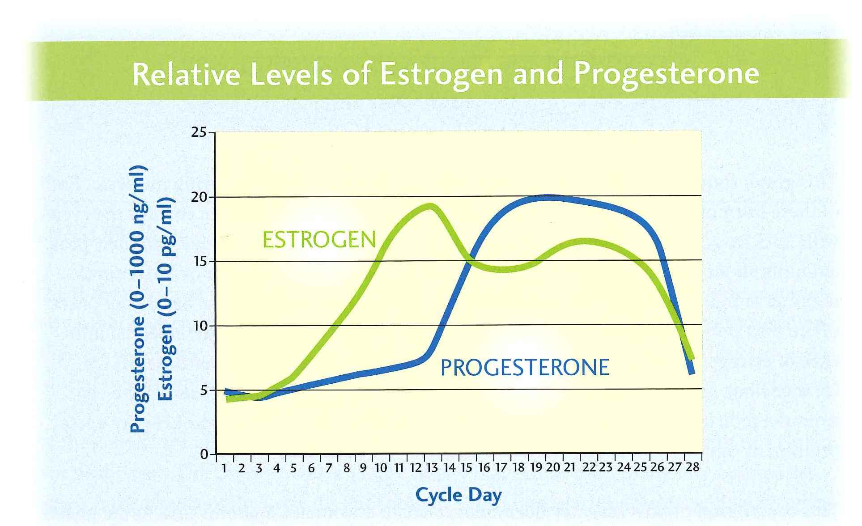

Slide 8
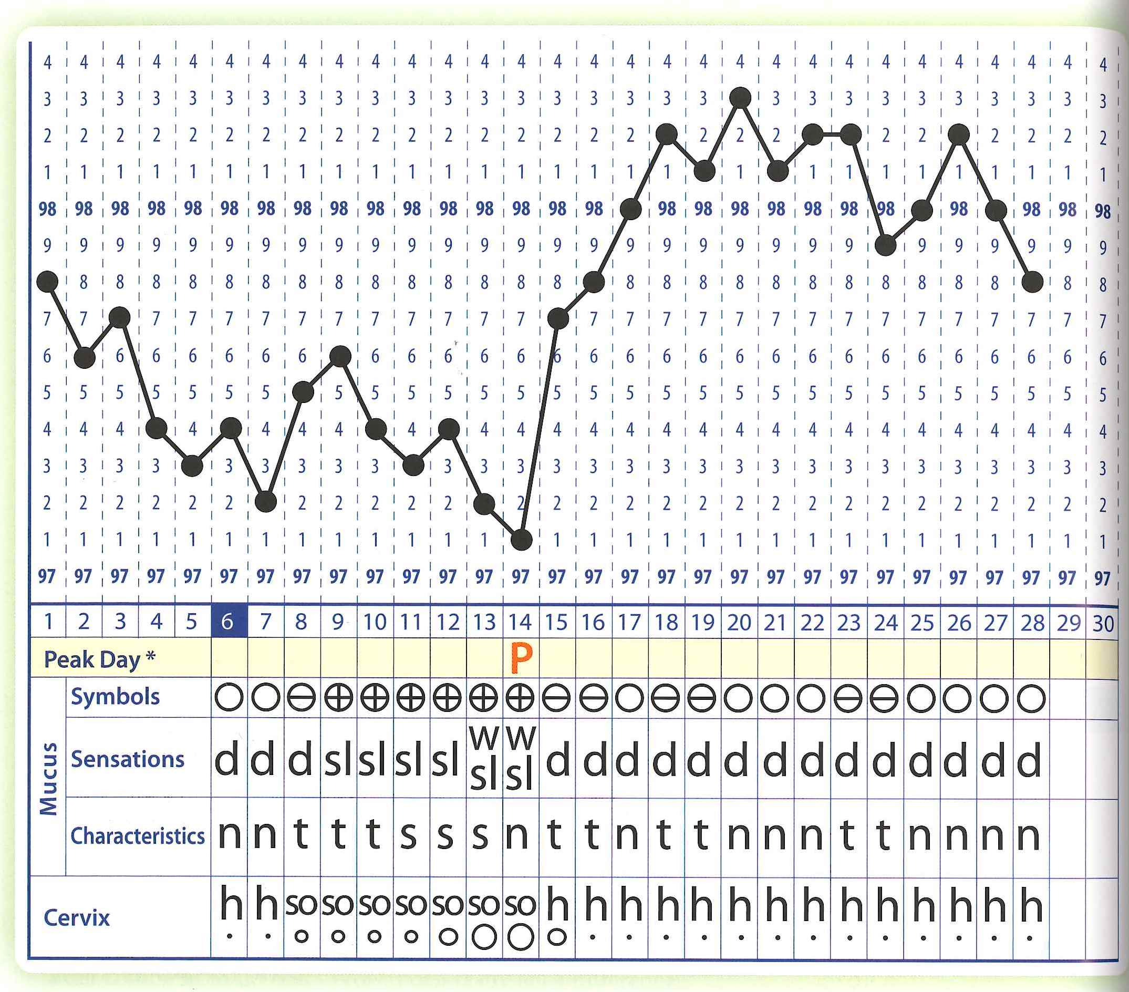

Slide 10
Commentary on Hollinger
Protestant theological/ethical rationale?
On Augustine vs. Aquinas
Aquinas’ three ends: procreation, unity, and pleasure

Slide 11
Argument 1: Stewardship of ‘nature’
Human stewardship involves intervention into ‘nature’
‘Nature’ includes bodies and their procreative functions
Therefore, human stewardship includes the possibility of contraception

Slide 12
Stewardship of nature
“In creating the world God gave man the power and the duty to form the world in spirit and freedom and, through his creative capacity, to actuate his own personal nature…The story of God and of man, therefore, should be seen as a shared work. And it should be seen that man’s tremendous progress in control of matter by technical means, and the universal and total ‘intercommunication’ that he has achieved, correspond perfectly to the divine decrees.”
-Majority Papal Commission Report, in The Catholic Case for Contraception (Macmillan, 1969), 150.

Slide 13
Stewardship
Human stewardship entails intervening in some things and not others.
Male-female distinction is not a permissible area of intervention.
Humanity’s distinct species is not.
Procreation is not.
Contraception is a permissible area of intervention, so long as the “procreative context of sexual relations” is maintained.

Slide 14
Problem
“The natural cycle suggests that we are not at the mercy of nature alone in stewarding procreation” (694).
Because sex sometimes does not result in children, we have the right to intervene to insure that it does not result in children.
Analogy: male-female distinction? Genetic modification? People dying?
Challenge: how does Hollinger distinguish between what is normative and shouldn’t be changed and what can be? What is good ‘medicine’ and what goes beyond proper limits?

Slide 15
Implications for other issues
Some couples are naturally infertile.
Therefore, fertility is not an essential component to the marriage relationship.
It follows: couples who are not naturally infertile can choose to not have children at all.
Same-sex couples can be ‘married.’

Slide 16
Argument 2: Multiple ends
Sex has multiple ends.
Those ends must be present when you look at the relationship as a whole, but need not be present in each act (Principle of totality)
Would Hollinger hold the same for the other ends?
Confusion: essential vs. exclusive

Slide 17
Meaning
“Within marriage the sex act retains its meaning even when no possibility of pregnancy is present” (696) – Stanley Grenz
Therefore, we are free to ensure that there is no possibility of pregnancy.

Slide 18
The secular case for contraception
Human rights: if people are not allowed a choice over whether or not to have children, their autonomy and freedom to control their lives is seriously restricted
Health benefits
Family planning
Gender equality
Any restriction of birth control is sexual discrimination
Pregnancy makes women dependent on their spouse/partner
Population control

